Slide 1

Function values
2001: A Space Odyssey
A game changer

Slide 2
Recall
Among other things, a hallmark of functional programming languages is that they consider function values to be first-class citizens in the language.
Function values can participate in any suitable operation. For example,
the evaluation of expressions can produce function values,
tuple elements can be function values,
a function value can be the actual parameter of a function call,
a function can return a function value as its result
Note that determining whether two functions are semantically equivalent is undecidable. Therefore, function types are not equality types.

Slide 3
The (Anonymous) Function value
fn id => expression
λ id . expression

Slide 4
Syntax
expression ::= …
…
factor ::= base | …
base ::= id
| ( expression )
| …
| value
value ::= integer_value
| boolean_value
| …
| function_value

Slide 5
suitable operations
An identifier may be bound to a function value via pattern matching.
A function value is an expression and can be used in any context where an expression can be used (provided the use is well-typed). For example,
A function value can be an element of a list.
A function value can be an element of a tuple.
A function value can be applied to a value – specifically, an actual parameter that has been reduced to a value.
Function application has the highest precedence.

Slide 6
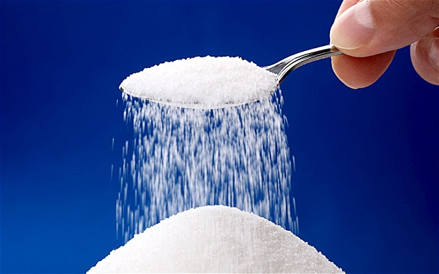
Some Syntactic sugar
fun name param = expression
→
val name = fn param => expression

Slide 7
Example Evaluation
fun sq x = x * x;
val y = 5;
sq y;
sq y;
→
(fn x => x * x) y;
→
(fn x => x * x) 5;
→
→
5 * 5;
val sq = fn x => x * x;
val y = 5;
sq y;
→
25;

Slide 8
More Examples
expression | normal form
(fn x => x + 1) 5 | 6
(fn x => x + 1) 5 * 8 | 48
(fn x => x + 1) (5 * 8) | 41
(fn x => fn y => x + y) 5 | (fn y => 5 + y)
(fn x => fn y => x + y) 5 6 | 11
(fn x => 5 + 6) | (fn x => 5 + 6)

Slide 9
A more involved evaluation sequence
(fn x => if x > 0 then (fn y => x + y) else (fn y => y - x)) 5 6
→
(if 5 > 0 then (fn y => 5 + y) else (fn y => y - 5)) 6
→
(if true then (fn y => 5 + y) else (fn y => y - 5)) 6
→
(fn y => 5 + y) 6
→
5 + 6
→
11

Slide 10

Curried Functions
The cat’s meow

Slide 11
More syntactic sugar
fun name param₁ param₂ … param_{n} = expression;
→
fun name param₁ … param_{n-1} = (fn param_{n} => expression);
→*
val name = (fn param₁ =>
(fn param₂ =>
…
(fn param_{n} => expression
)
…
)
);

Slide 12
fun f0 x y = x – y;
val f1 = (fn x => (fn y => x – y) );
val f2 = (fn y => (fn x => x – y) );
(* The input to test should be a single tuple and not 2
(curried) parameters. *)
fun test (v,w) =
let
val result0 = f0 v w;
val result1 = f1 v w;
val result2 = f2 v w;
in
if result0 = result1 then print “\nf0 = f1\n” else ();
if result0 = result2 then print “\nf0 = f2\n” else ()
end;
test (10, 2);

Slide 13
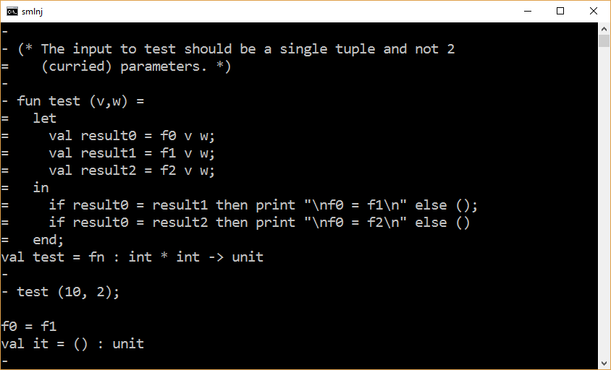
Conclusion 1: The f2 translation is incorrect.
Conclusion 2: The f1 translation is correct for the given input.

Slide 14
Examples

Slide 15
Example 1
fun isMember _ [] = false
| isMember x (y::ys) = x = y orelse isMember x ys;
val scoccerClub = [“sam”, “laurie”, “john”];
val chessClub = [“bob”, “sally”, “john”, “bill”];
val johnIsMemberOf = isMember “john”;
johnIsMemberOf soccerClub andalso johnIsMemberOf chessClub;

Slide 16
Example 2
fun addToAll (_, []) = []
| addToAll (x, y::ys) = x + y :: addToAll (x,ys);
addToAll (5, [1,2,3,4,5]);
fun multToAll (_, []) = []
| multToAll (x, y::ys) = x * y :: multToAll (x,ys);
multToAll (5, [1,2,3,4,5]);

Slide 17
fun map _ [] = []
| map f (y::ys) = f y :: map f ys;
fun add x y = x + y;
fun mult x y = x * y;
map (add 5) [1,2,3,4,5];
map (mult 5) [1,2,3,4,5];

Slide 18
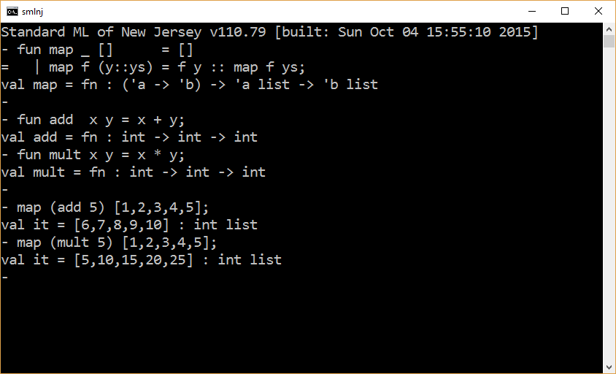

Slide 19
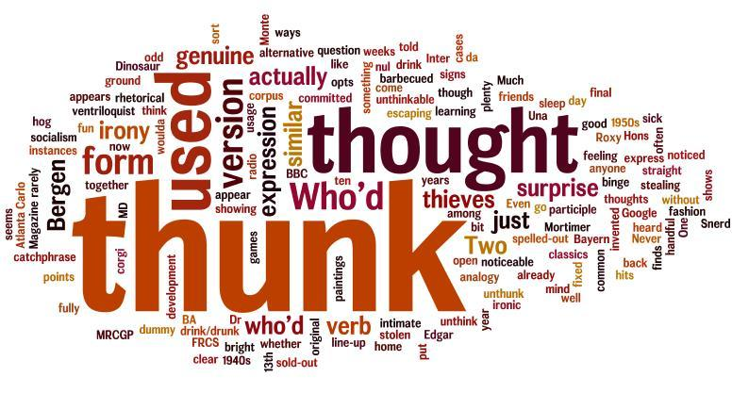
Suspending Computation
Triggering the evaluation of function bodies

Slide 20
Thunk – A history
The early years of compiler research saw broad experimentation with different evaluation strategies. A key question was how to compile a subroutine call if the arguments can be arbitrary mathematical expressions rather than constants. One approach, known as "call by value," calculates all of the arguments before the call and then passes the resulting values to the subroutine. In the rival "call by name" approach, the subroutine receives the unevaluated argument expression and must evaluate it.
A simple implementation of "call by name" might substitute the code of an argument expression for each appearance of the corresponding parameter in the subroutine, but this can produce multiple versions of the subroutine and multiple copies of the expression code. As an improvement, the compiler can generate a helper subroutine, called a thunk, that calculates the value of the argument. The address of this helper subroutine is then passed to the original subroutine in place of the original argument, where it can be called as many times as needed. Prof. Peter Ingerman first described thunks in reference to the ALGOL 60 programming language, which supported call-by-name evaluation.
https://en.wikipedia.org/wiki/Thunk

Slide 21
Thunks in Functional Programming
Although the software industry largely standardized on call-by-value and call-by-reference evaluation, active study of call-by-name continued in the functional programming community. This research produced a series of lazy evaluation programming languages in which some variant of call-by-name is the standard evaluation strategy. Compilers for these languages, such as the Glasgow Haskell Compiler, have relied heavily on thunks, with the added feature that the thunks save their initial result so that they can avoid recalculating it; this is known as memoization.
Functional programming languages have also allowed programmers to explicitly generate thunks. This is done in source code by wrapping an argument expression in an anonymous function that has no parameters of its own. This prevents the expression from being evaluated until a receiving function calls the anonymous function, thereby achieving the same effect as call-by-name.^{[5]} The adoption of anonymous functions into other programming languages has made this capability widely available.
https://en.wikipedia.org/wiki/Thunk

Slide 22
Simulating Short-Ciruited Evaluation
A conditional expression
consists of 3 expressions
only evaluates 2 (out of 3) expressions
val x = 0;
if x = 0 then 0 else 5 div x;

Slide 23
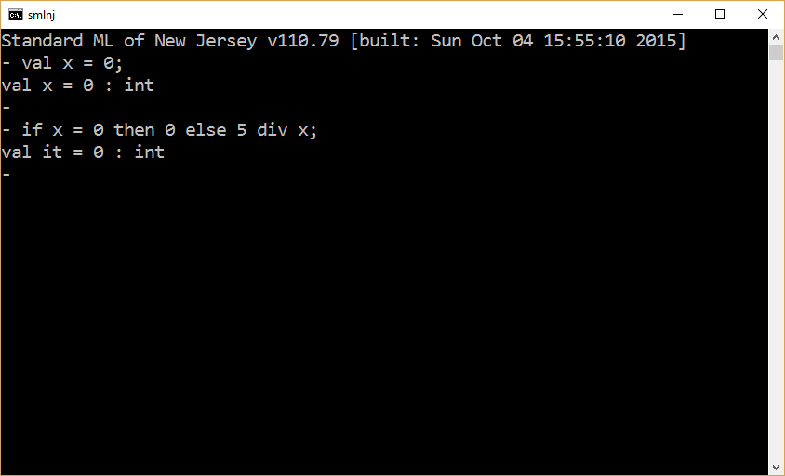

Slide 24
Implementing a conditional evaluation function – Attempt 1
fun conditional(e1,e2,e3) = if e1 then e2 else e3;
val x = 0;
(if x = 0 then 0 else 5 div x) = conditional(x = 0, 0, 5 div x);

Slide 25
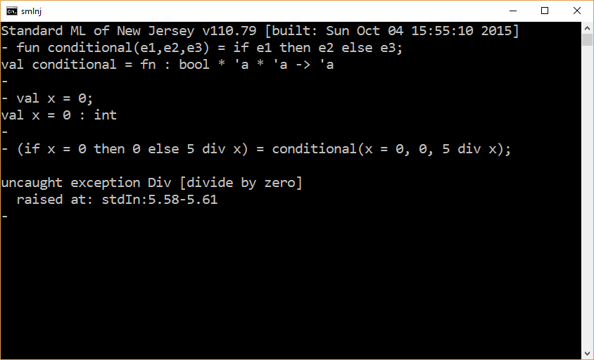

Slide 26
Implementing a conditional evaluation function – Attempt 1
fun conditional(e1,thunk1,thunk2) =
if e1 then thunk1() else thunk2();
val x = 0;
(if x = 0 then 0 else 5 div x)
=
conditional(x = 0, , );
fn () => 0
fn () => 5 div x

Slide 27
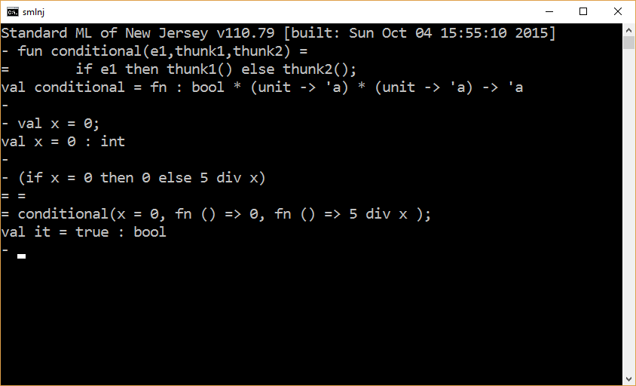

Slide 28
The end

